Slide 1

CS-STREAMING:
How to compete with netflix
By: Streamsavvy solutions

Slide 2
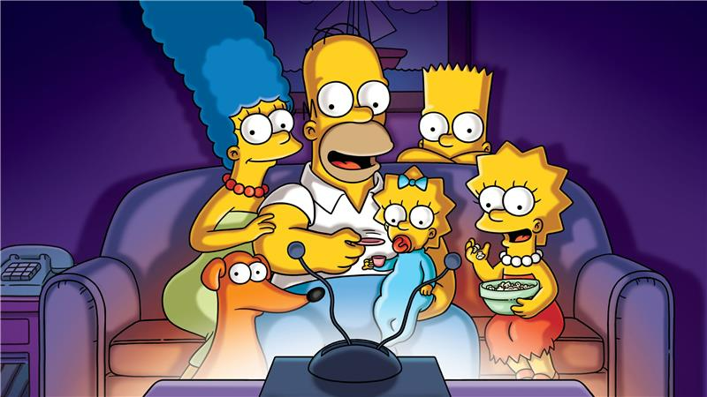
Streamsavvy solutions
Introduction
CS Streaming is looking to launch a new streaming service and we have analysed the Netflix data provided to present trends and insights to launch their new product in competition with Netflix
Netflix is a subscription based streaming service that allows members to watch TV shows and movies on an internet connected device

Slide 3

Streamsavvy solutions
Dataset
The Netflix data was sourced from Kaggle and it contained 8,807 data entries
We used the data to identify trends and insights about Netflix services that CS streaming can use to understand Netflix
Among the content available there are more Movies than TV Shows

Slide 4
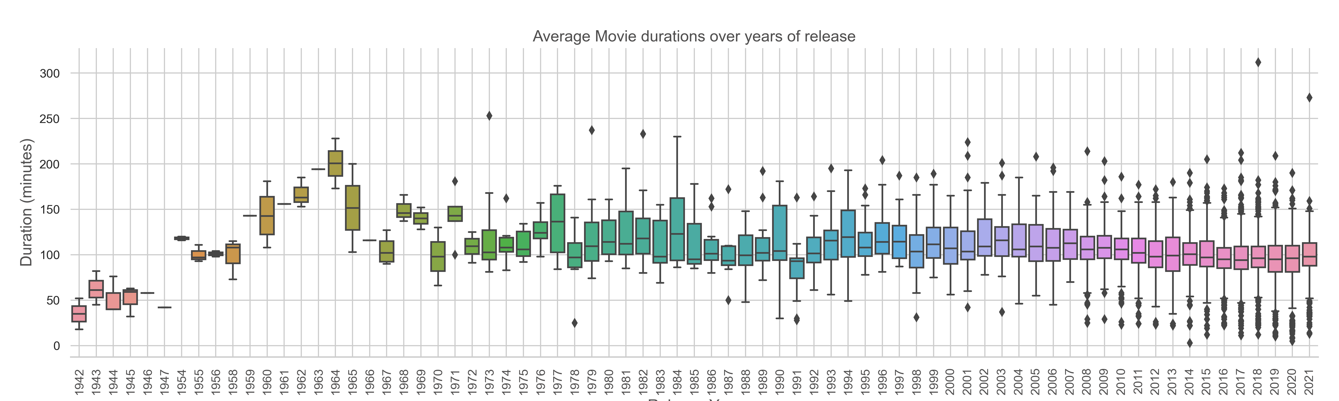
Streamsavvy solutions
“You Are What You Watch”
The New York Times Released an article called “You Are What You Watch” explaining “that the quality of shows can influence us in different ways, shaping our thinking and political preferences, even affecting our cognitive ability”
[Ref]
On average a movie lasts 90 minutes on Netflix

Slide 5
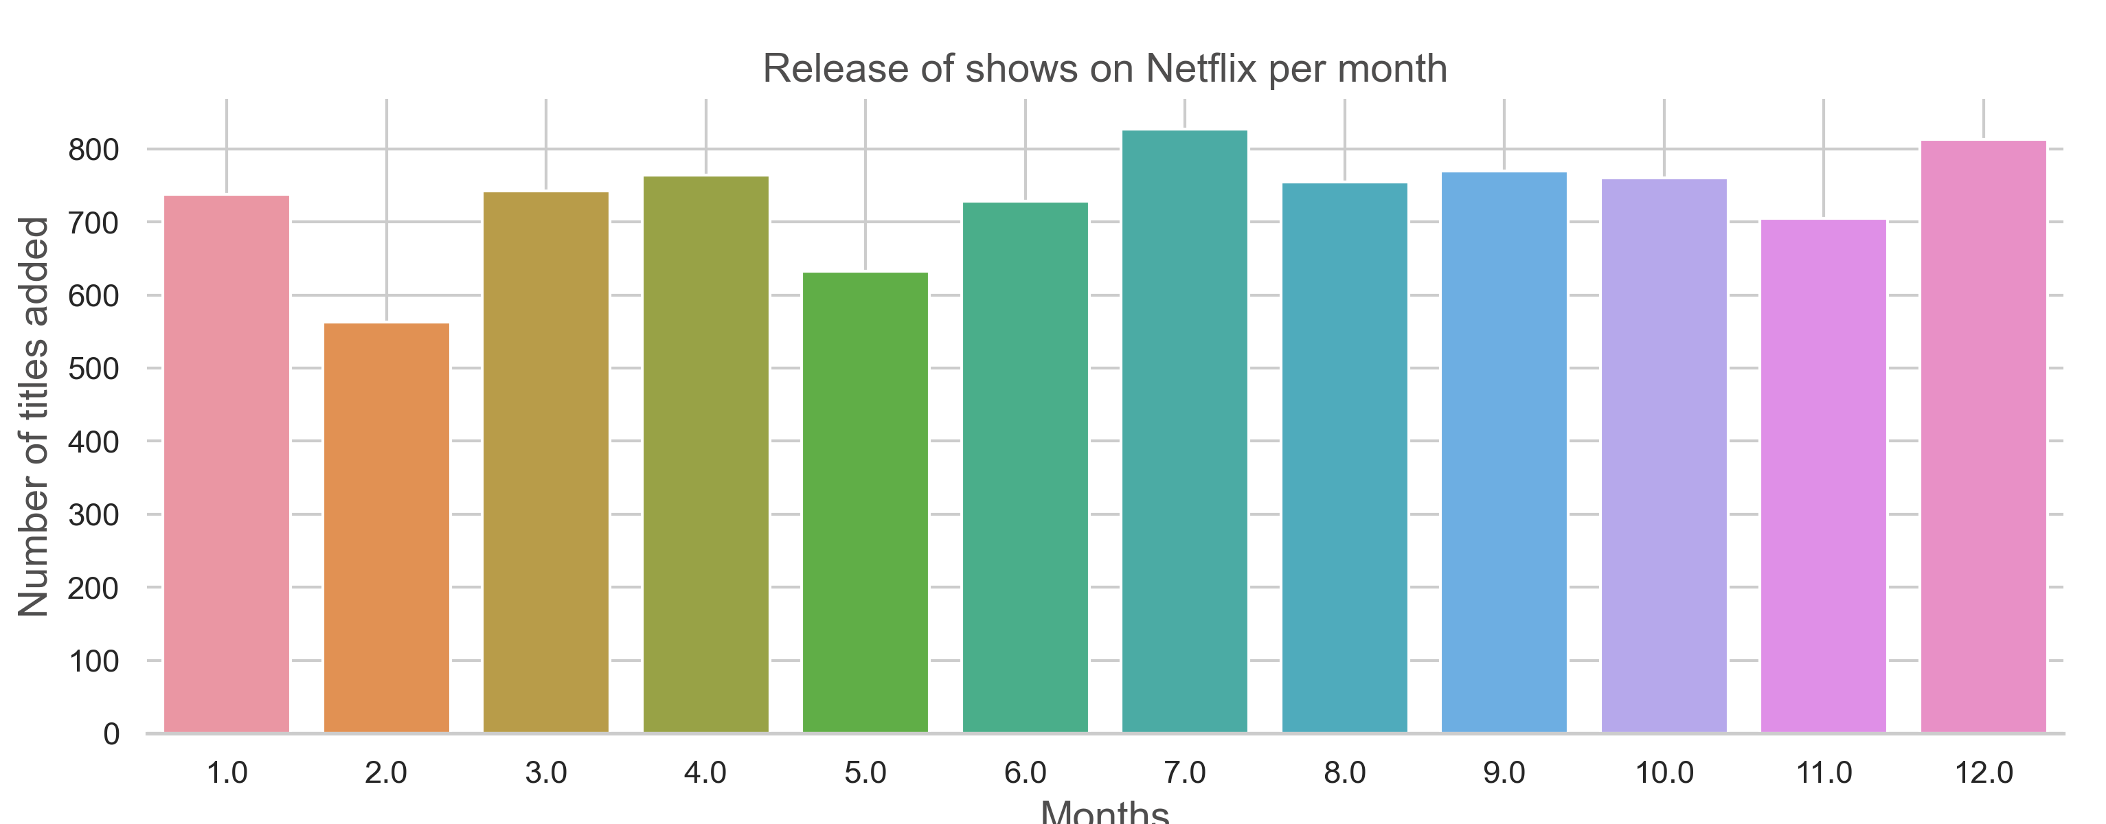
Streamsavvy solutions
Timing of Addition of shows on Netflix By Month
February is the month with the least number of releases

Slide 6
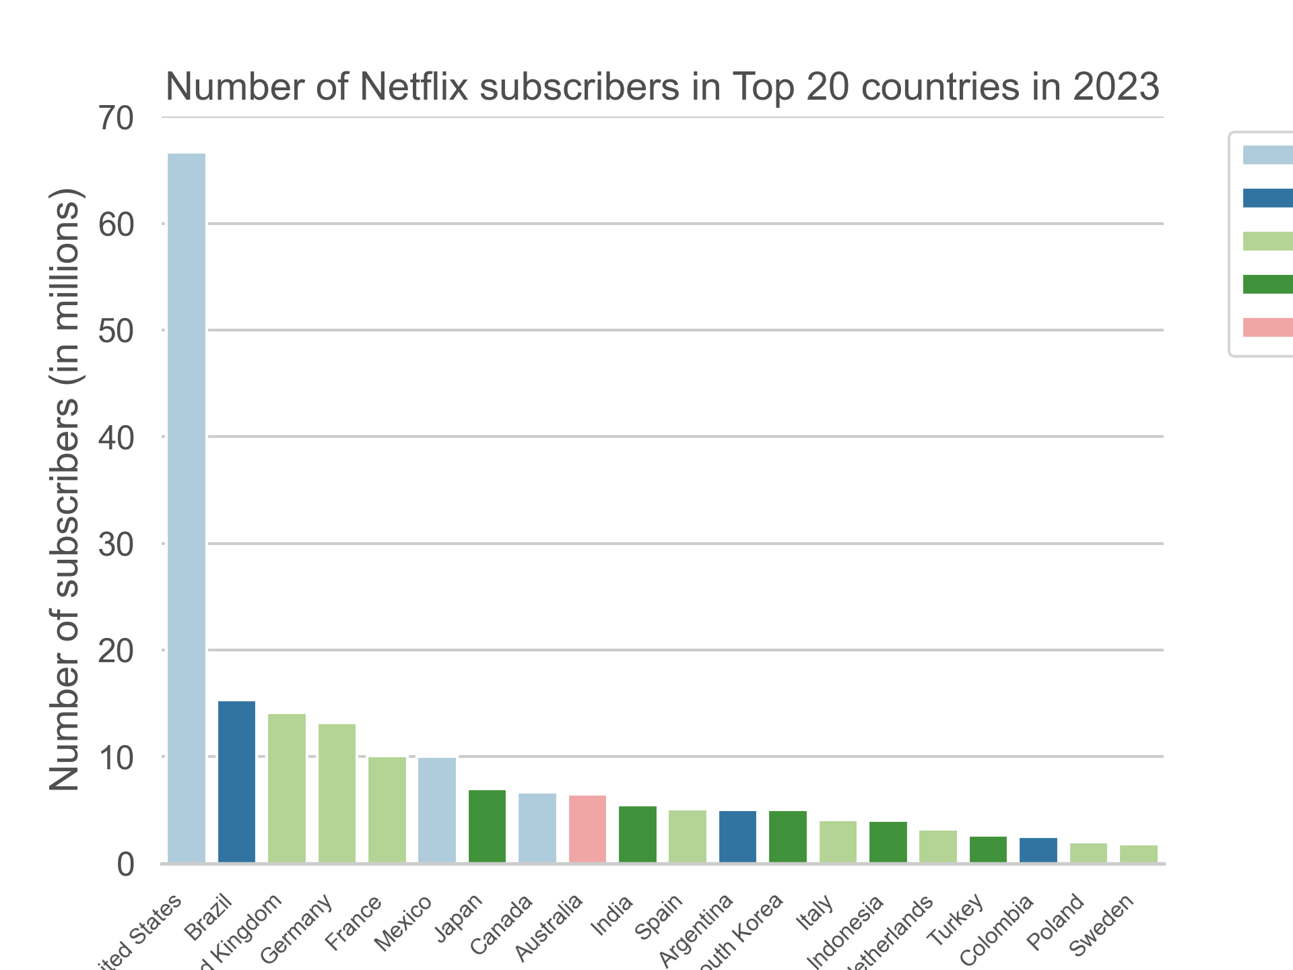
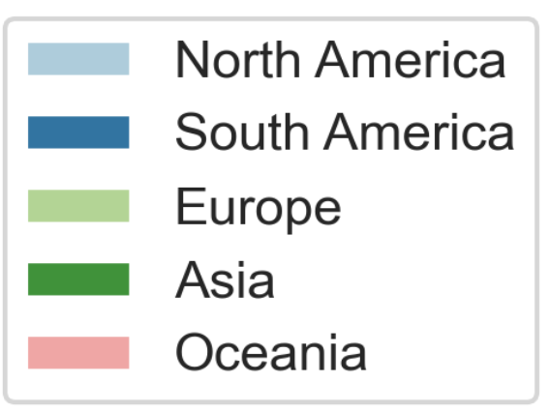
Streamsavvy solutions
Location of Netflix subscribers
Most of the subscribers are in the US

Slide 7
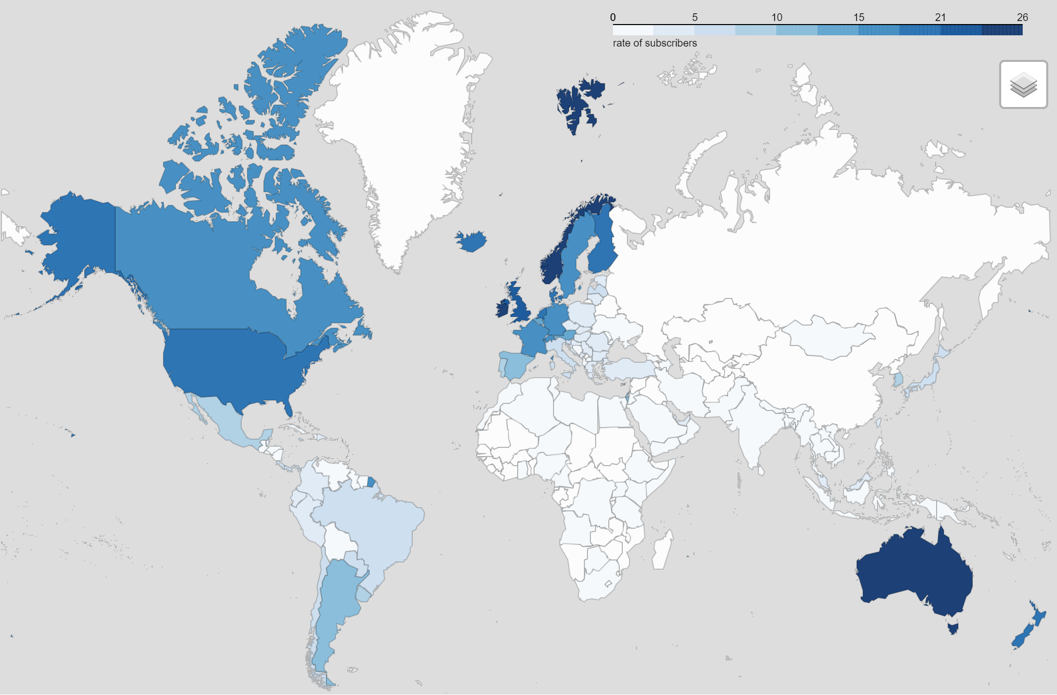
Streamsavvy solutions
Subscribers rate per capita
Netflix is predominantly in Western countries
Untapped markets

Slide 8
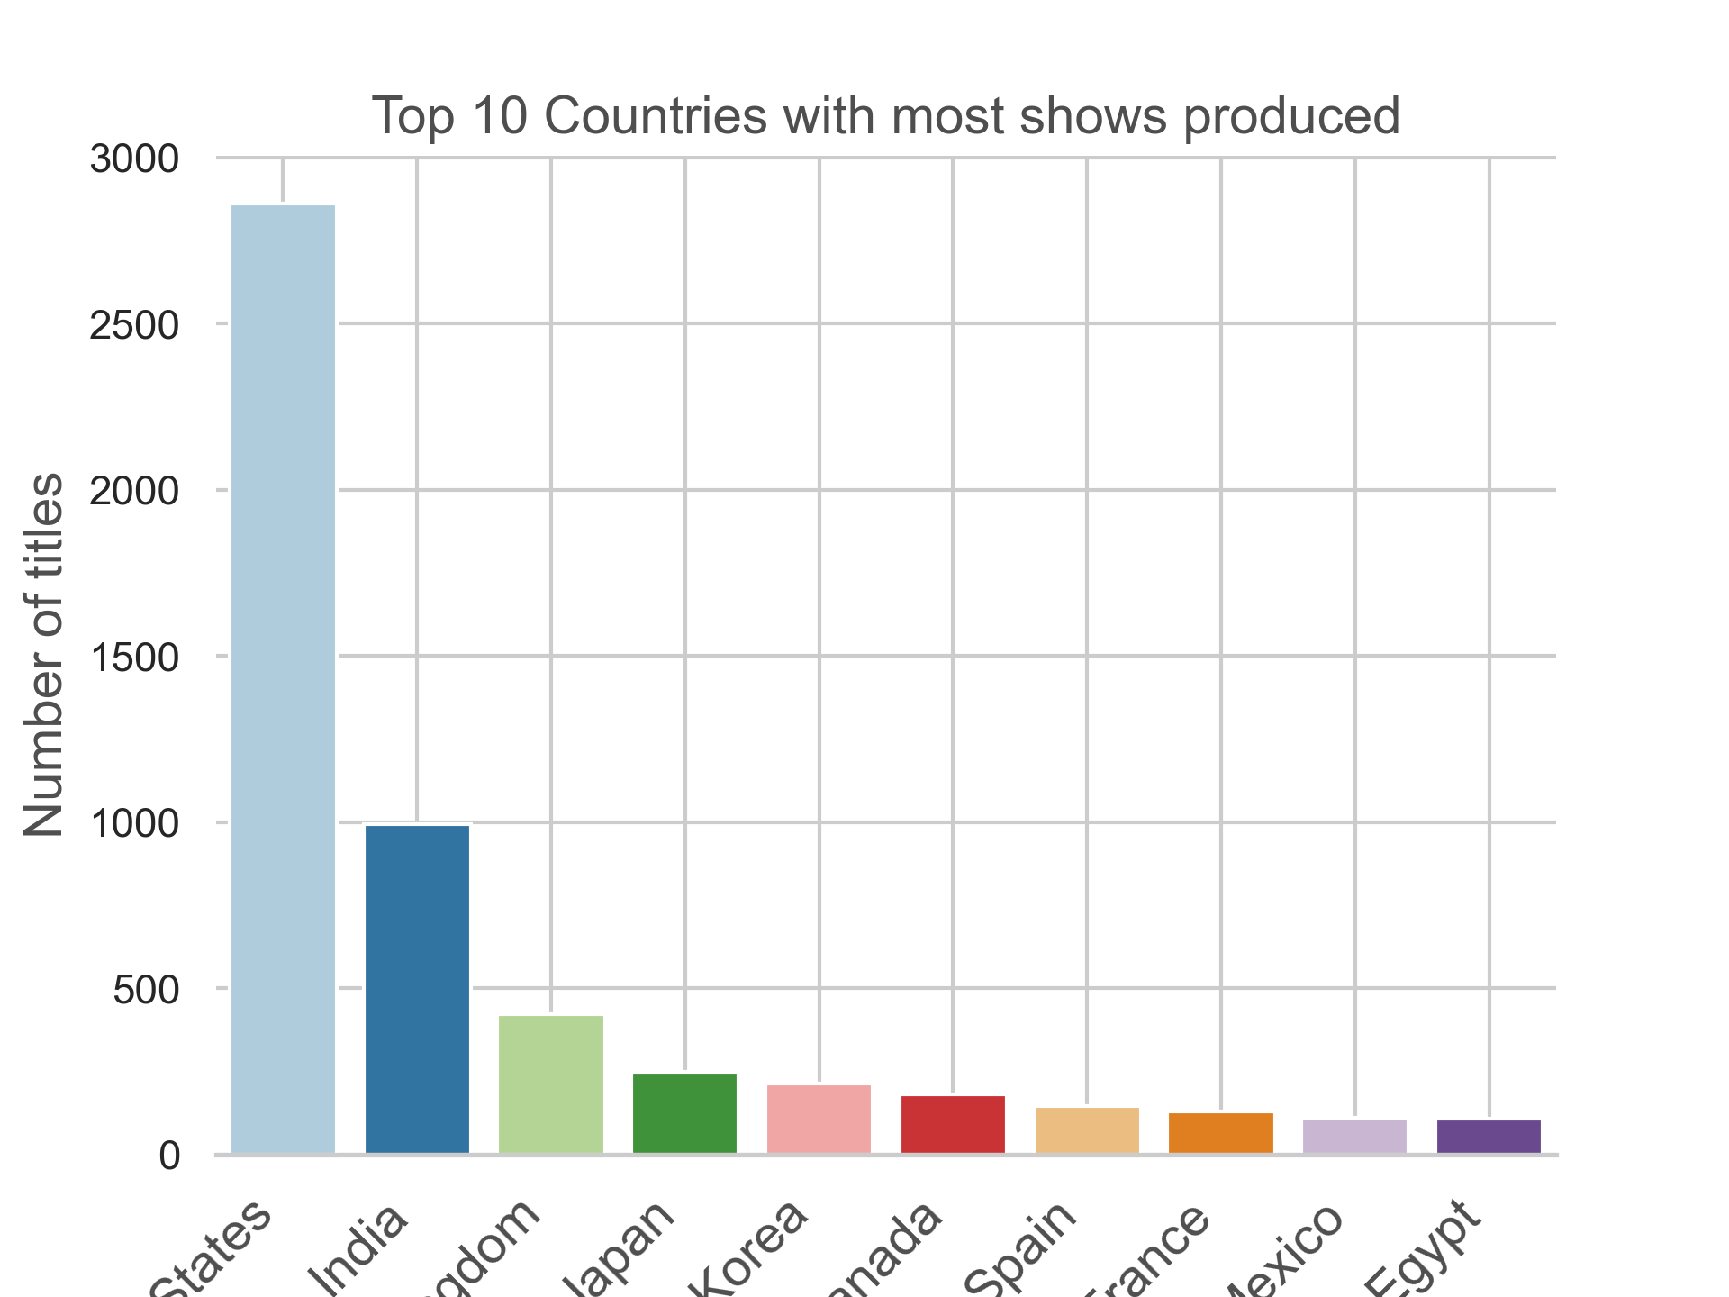
Streamsavvy solutions
The most shows are produced in
the US

Slide 9
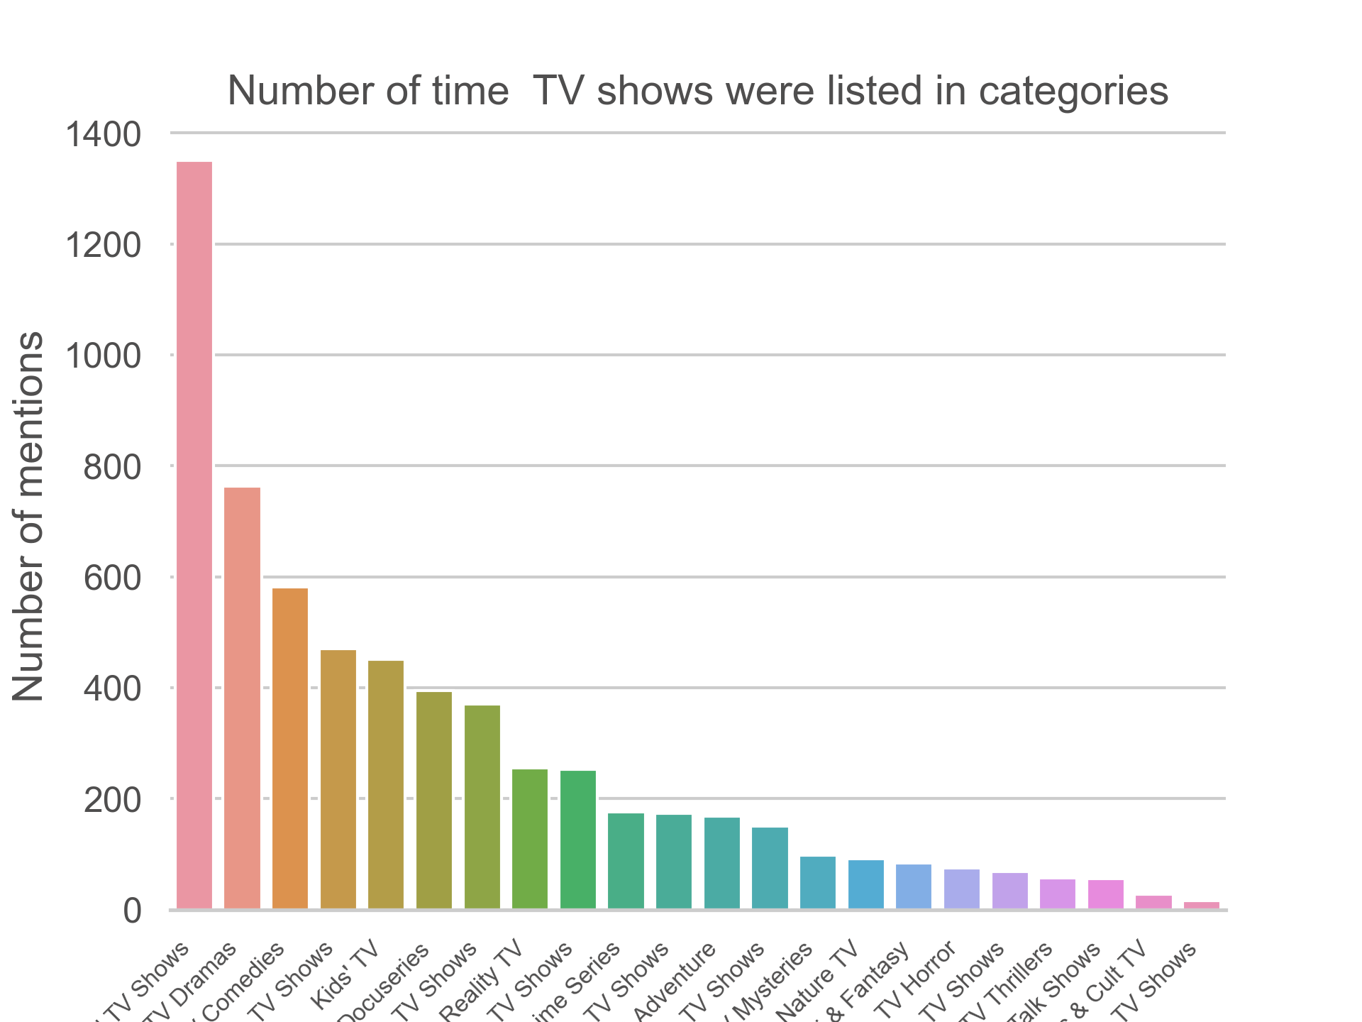
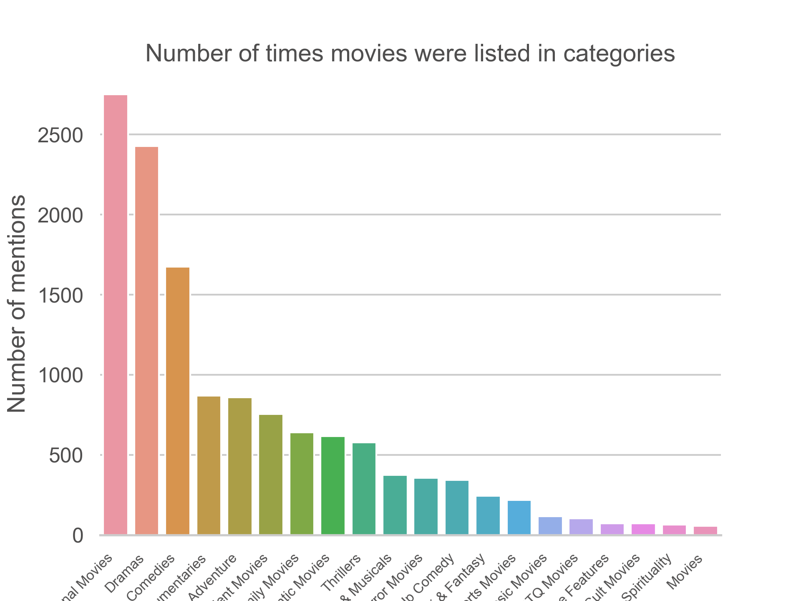
Streamsavvy solutions
Most prominent content
International, drama, comedy are the three most listed categories on Netflix

Slide 10
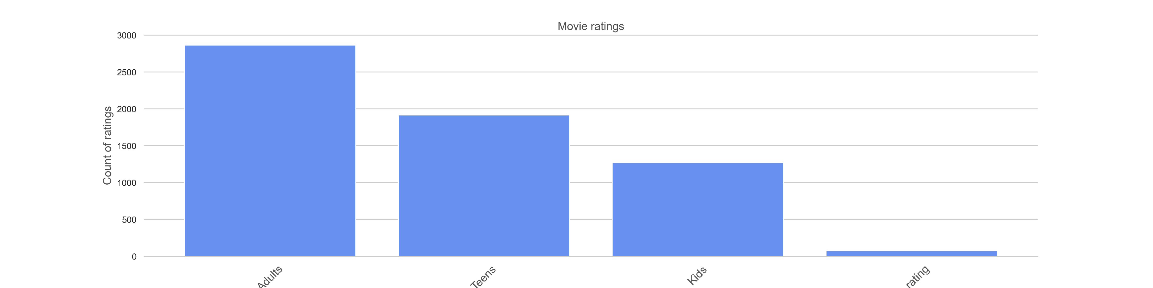
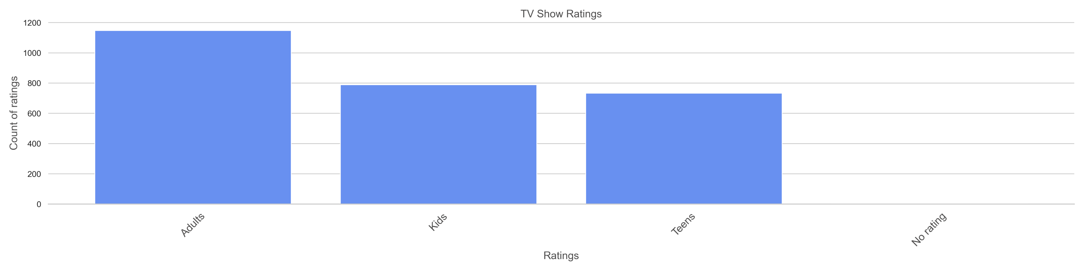
Streamsavvy solutions
Most prominent Movie Ratings
Most content on Netflix is catered towards Adults

Slide 11
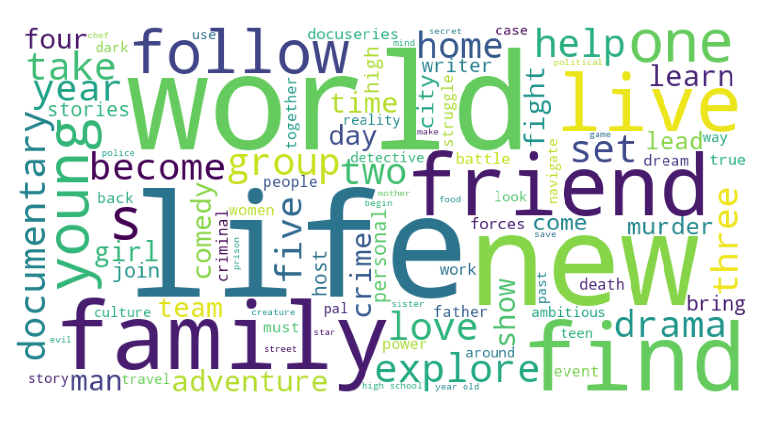
Western Countries
If we want can replicate Netflix we have to implement their use of life, emotions, happiness, family

Slide 12
Streamsavvy solutions
Conclusion
CS streaming can develop its streaming with two approaches
Untapped Market
Existing Netflix Market
CS Streaming will need to create relevant and localised content towards underrepresented regions
Netflix largely occupy the US and Europe
Creating Drama/Comedy based content that creates a positive and wholesome feeling
This includes Africa, Asia and parts of South America
Kids and Teenagers have untapped potential
Netflix data is showing a lot of data caters towards adults

Slide 13
Streamsavvy solutions

